Slide 2
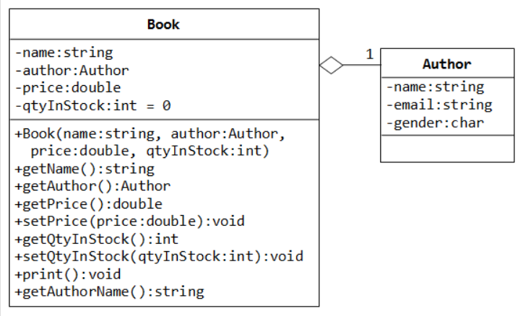
A Book is written by an Author - Using an "Object" Data Member
Let's design a Book class. Assume that a book is written by one and only one author. The Book class (as shown in the class diagram) contains the following members:
Four private data members: name (string), author (an instance of the class Author that we have created earlier), price (double), and qtyInStock (int, with default value of 0). The price shall be positive and the qtyInStock shall be zero or positive.
Take note that data member author is an instance (object) of the class Author, instead of a fundamental types (such as int, double). In fact, name is an object of the class string too.
The public getters and setters for the private data members. Take note that getAuthor() returns an object (an instance of class Author).
A public member function print(), which prints "'book-name' by author-name (gender) @ email".
A public member function getAuthorName(), which returns the name of the author of this Book instance.
The hallow diamond shape in the class diagram denotes aggregation (or has-a) association relationship. That is, a Book instance has one (and only one) Author instance as its component.

Slide 3
/* Header for the class Book (Book.h) */
#ifndef BOOK_H
#define BOOK_H
#include <string>
#include "Author.h" // Use the Author class
using namespace std;
class Book {
private:
string name;
Author author; // data member author is an instance of class Author
double price;
int qtyInStock;
public:
Book(string name, Author author, double price, int qtyInStock = 0);
string getName() const; // To recieve an instance of class Author as argument
Author getAuthor() const; // Returns an instance of the class Author
double getPrice() const;
void setPrice(double price);
int getQtyInStock() const;
void setQtyInStock(int qtyInStock);
void print() const;
string getAuthorName() const;
};
#endif

Slide 4
/* Implementation for the class Book (Book.cpp) */
#include <iostream>
#include "Book.h"
using namespace std;
// Constructor, with member initializer list to initialize the// component Author instance
Book::Book(string name, Author author, double price, int qtyInStock)
: name(name), author(author) { // Must use member initializer list to construct object
setPrice(price); // Call setters to validate price and qtyInStock
setQtyInStock(qtyInStock);
}
string Book::getName() const {
return name;
}
Author Book::getAuthor() const {
return author;
}
double Book::getPrice() const {
return price;
}

Slide 5
void Book::setPrice(double price) {// Validate price, which shall be positive
if (price > 0) {
this->price = price;
} else {
cout << "price should be positive! Set to 0" << endl;
this->price = 0;
}}
int Book::getQtyInStock() const {
return qtyInStock;
}
void Book::setQtyInStock(int qtyInStock) {// Validate qtyInStock, which cannot be negative
if (qtyInStock >= 0) {
this->qtyInStock = qtyInStock;
} else {
cout << "qtyInStock cannot be negative! Set to 0" << endl;
this->qtyInStock = 0;
}}
void Book::print() const {// print in the format ""Book-name" by author-name (gender) at email"
cout << "'" << name << "' by ";
author.print();
}
string Book::getAuthorName() const {// Return the author' name for this Book
return author.getName(); // invoke the getName() on instance author
}

Slide 6
#include <iostream>/* Test Driver for the Book class (TestBook.cpp) */
#include "Book.h"
using namespace std;
int main() {
// Declare and construct an instance of Author
Author peter("Peter Jones", "peter@somewhere.com", 'm');
peter.print(); // Peter Jones (m) at peter@somewhere.com
// Declare and construct an instance of Book
Book cppDummy("C++ for Dummies", peter, 19.99);
cppDummy.setQtyInStock(88);
cppDummy.print();
// 'C++ for Dummies' by Peter Jones (m) at peter@somewhere.com
cout << cppDummy.getQtyInStock() << endl; // 88
cout << cppDummy.getPrice() << endl; // 19.99
cout << cppDummy.getAuthor().getName() << endl; // "Peter Jones"
cout << cppDummy.getAuthor().getEmail() << endl; // "peter@somewhere.com"
cout << cppDummy.getAuthorName() << endl; // "Peter Jones"
Book moreCpp("More C++ for Dummies", peter, -19.99);
// price should be positive! Set to 0
cout << moreCpp.getPrice() << endl; // 0
}

Slide 7
Pointers, References and Dynamic Memory Allocation
Pointers, References and Dynamic Memory Allocation are the most powerful features in C/C++ language, which allows programmers to directly manipulate memory to efficiently manage the memory - the most critical and scarce resource in computer - for best performance.
However, "pointer" is also the most complex and difficult feature in C/C++ language.
Pointers are extremely powerful because they allows you to access addresses and manipulate their contents. But they are also extremely complex to handle. Using them correctly, they could greatly improve the efficiency and performance.
On the other hand, using them incorrectly could lead to many problems, from un-readable and un-maintainable codes, to infamous bugs such as memory leaks and buffer overflow, which may expose your system to hacking.
Many new languages (such as Java and C#) remove pointer from their syntax to avoid the pitfalls of pointers, by providing automatic memory management.
Although you can write C/C++ programs without using pointers, however, it is difficult not to mention pointer in teaching C/C++ language.

Slide 8
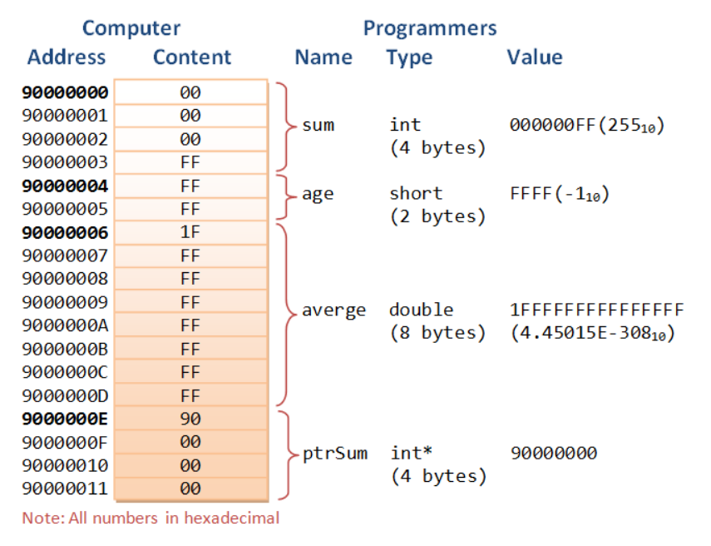
Pointer Variables
A computer memory location has an address and holds a content. The address is a numerical number (often expressed in hexadecimal), which is hard for programmers to use directly. Typically, each address location holds 8-bit (i.e., 1-byte) of data. It is entirely up to the programmer to interpret the meaning of the data, such as integer, real number, characters or strings.
To ease the burden of programming using numerical address and programmer-interpreted data, early programming languages (such as C) introduce the concept of variables. A variable is a named location that can store a value of a particular type. Instead of numerical addresses, names (or identifiers) are attached to certain addresses. Also, types (such as int, double, char) are associated with the contents for ease of interpretation of data.
Each address location typically hold 8-bit (i.e., 1-byte) of data. A 4-byte int value occupies 4 memory locations. A 32-bit system typically uses 32-bit addresses. To store a 32-bit address, 4 memory locations are required.

Slide 9
Pointers must be declared before they can be used, just like a normal variable. The syntax of declaring a pointer is to place a * in front of the name. A pointer is associated with a type (such as int and double) too.
type *ptr; // Declare a pointer variable called ptr as a pointer of type
// or
type* ptr;
// or
type * ptr; // I shall adopt this convention
For example,
int * iPtr; // Declare a pointer variable called iPtr pointing to an int (an int pointer)
double * dPtr; // Declare a double pointer
Take note that you need to place a * in front of each pointer variable, in other words, * applies only to the name that followed. The * in the declaration statement is not an operator, but indicates that the name followed is a pointer variable. For example,
int *p1, *p2, i; // p1 and p2 are int pointers. i is an int
int* p1, p2, i; // p1 is a int pointer, p2 and i are int
int * p1, * p2, i; // p1 and p2 are int pointers, i is an int
Naming Convention of Pointers: Include a "p" or "ptr" as prefix or suffix, e.g., iPtr, numberPtr, pNumber, pStudent.
Declaring Pointers

Slide 10
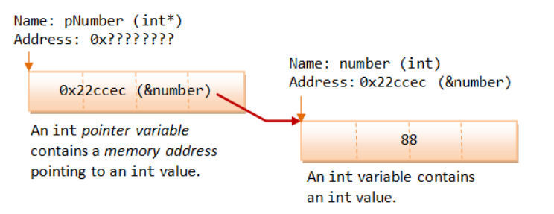
Initializing Pointers via the Address-Of Operator (&)
When you declare a pointer variable, its content is not initialized. In other words, it contains an address of "somewhere", which is of course not a valid location. This is dangerous! You need to initialize a pointer by assigning it a valid address.
The address-of operator (&) operates on a variable, and returns the address of the variable.
You can use the address-of operator to get the address of a variable, and assign the address to a pointer variable.:
int number = 88; // An int variable with a value
int * pNumber; // Declare a pointer variable called pNumber pointing to an int (or int pointer)
pNumber = &number; // Assign the address of the variable number to pointer pNumber
int * pAnother = &number; // Declare another int pointer and init to address of the variable number

Slide 11
Indirection or Dereferencing Operator (*)
The indirection operator (or dereferencing operator) (*) operates on a pointer, and returns the value stored in the address kept in the pointer variable.
int number = 88;
int * pNumber = &number; // Declare and assign the address of variable number to pointer pNumber (0x22ccec)
cout << pNumber<< endl; // Print the content of the pointer variable, which contain an address (0x22ccec)
cout << *pNumber << endl; // Print the value "pointed to" by the pointer, which is an int (88)
*pNumber = 99; // Assign a value to where the pointer is pointed to, NOT to the pointer variable
cout << *pNumber << endl; // Print the new value "pointed to" by the pointer (99)
cout << number << endl; // The value of variable number changes as well (99)
Take note that pNumber stores a memory address location, whereas *pNumber refers to the value stored in the address kept in the pointer variable, or the value pointed to by the pointer.
A variable (such as number) directly references a value, whereas a pointer indirectly references a value through the memory address it stores.
The indirection operator (*) can be used in both the RHS (temp = *pNumber) and the LHS (*pNumber = 99) of an assignment statement.

Slide 12
Pointer has a Type Too
A pointer is associated with a type (of the value it points to), which is specified during declaration.
A pointer can only hold an address of the declared type; it cannot hold an address of a different type.
int i = 88;
double d = 55.66;
int * iPtr = &i; // int pointer pointing to an int value
double * dPtr = &d; // double pointer pointing to a double value
iPtr = &d; // ERROR, cannot hold address of different type
dPtr = &i; // ERROR
iPtr = i; // ERROR, pointer holds address of an int, NOT int value
int j = 99;
iPtr = &j; // You can change the address stored in a pointer

Slide 13
/* Test pointer declaration and initialization */
#include <iostream>
using namespace std;
int main() {
int number = 88; // Declare an int variable and assign an initial value
int * pNumber; // Declare a pointer variable pointing to an int (or int pointer)
pNumber = &number; // assign the address of the variable number to pointer pNumber
cout << pNumber << endl; // Print content of pNumber (0x22ccf0)
cout << &number << endl; // Print address of number (0x22ccf0)
cout << *pNumber << endl; // Print value pointed to by pNumber (88)
cout << number << endl; // Print value of number (88)
*pNumber = 99; // Re-assign value pointed to by pNumber
cout << pNumber << endl; // Print content of pNumber (0x22ccf0)
cout << &number << endl; // Print address of number (0x22ccf0)
cout << *pNumber << endl; // Print value pointed to by pNumber (99)
cout << number << endl; // Print value of number (99)
// The value of number changes via pointer
cout << &pNumber << endl; // Print the address of pointer variable pNumber (0x22ccec)
}

Slide 14
Uninitialized Pointers
The following code fragment has a serious logical error!
int * iPtr;
*iPtr = 55;
cout << *iPtr << endl;
The pointer iPtr was declared without initialization, i.e., it is pointing to "somewhere" which is of course an invalid memory location.
The *iPtr = 55 corrupts the value of "somewhere"! You need to initialize a pointer by assigning it a valid address. Most of the compilers does not signal an error or a warning for uninitialized pointer?!
Null Pointers
You can initialize a pointer to 0 or NULL, i.e., it points to nothing. It is called a null pointer. Dereferencing a null pointer (*p) causes an STATUS_ACCESS_VIOLATION exception.
int * iPtr = 0; // Declare an int pointer, and initialize the pointer to point to nothing
cout << *iPtr << endl; // ERROR! STATUS_ACCESS_VIOLATION exception
int * p = NULL; // Also declare a NULL pointer points to nothing
Initialize a pointer to null during declaration is a good software engineering practice.
C++11 introduces a new keyword called nullptr to represent null pointer.

Slide 15
Reference Variables
C++ added the so-called reference variables (or references in short). A reference is an alias, or an alternate name to an existing variable. For example, suppose you make peter a reference (alias) to paul, you can refer to the person as either peter or paul.
The main use of references is acting as function formal parameters to support pass-by-reference. In an reference variable is passed into a function, the function works on the original copy (instead of a clone copy in pass-by-value). Changes inside the function are reflected outside the function.
A reference is similar to a pointer. a reference can be used as an alternative to pointer, in particular, for the function parameter.
References (or Aliases) (&)
Recall that C/C++ use & to denote the address-of operator in an expression. C++ assigns an additional meaning to & in declaration to declare a reference variable.
The meaning of symbol & is different in an expression and in a declaration. When it is used in an expression, & denotes the address-of operator, which returns the address of a variable, e.g., if number is an int variable, &number returns the address of the variable number (this has been described in the above section).
However, when & is used in a declaration (including function formal parameters), it is part of the type identifier and is used to declare a reference variable (or reference or alias or alternate name). It is used to provide another name, or another reference, or alias to an existing variable.
type &newName = existingName; // or
type& newName = existingName; // or
type & newName = existingName; // I shall adopt this convention
It shall be read as "newName is a reference to exisitngName", or "newName is an alias of existingName". You can now refer to the variable as newName or existingName.

Slide 16
/* Test reference declaration and initialization */
#include <iostream>
using namespace std;
int main() {
int number = 88; // Declare an int variable called number
int & refNumber = number; // Declare a reference (alias) to the variable number
// Both refNumber and number refer to the same value
cout << number << endl; // Print value of variable number (88)
cout << refNumber << endl; // Print value of reference (88)
refNumber = 99; // Re-assign a new value to refNumber
cout << refNumber << endl;
cout << number << endl; // Value of number also changes (99)
number = 55; // Re-assign a new value to number
cout << number << endl;
cout << refNumber << endl; // Value of refNumber also changes (55)
}

Slide 17
References vs. Pointers
Pointers and references are equivalent, except:
A reference is a name constant for an address. You need to initialize the reference during declaration.
int & iRef; // Error: 'iRef' declared as reference but not initialized
Once a reference is established to a variable, you cannot change the reference to reference another variable.
To get the value pointed to by a pointer, you need to use the dereferencing operator * (e.g., if pNumber is a int pointer, *pNumber returns the value pointed to by pNumber. It is called dereferencing or indirection).
To assign an address of a variable into a pointer, you need to use the address-of operator & (e.g., pNumber = &number).
On the other hand, referencing and dereferencing are done on the references implicitly:
For example, if refNumber is a reference (alias) to another int variable, refNumber returns the value of the variable. No explicit dereferencing operator * should be used. Furthermore, to assign an address of a variable to a reference variable, no address-of operator & is needed.

Slide 18
/* References vs. Pointers */
#include <iostream>
using namespace std;
int main() {
int number1 = 88, number2 = 22;
int * pNumber1 = &number1; // Create a pointer pointing to number1 // Explicit referencing
*pNumber1 = 99; // Explicit dereferencing
cout << *pNumber1 << endl; // 99
cout << &number1 << endl; // 0x22ff18
cout << pNumber1 << endl; // 0x22ff18 (content of the pointer variable - same as above)
cout << &pNumber1 << endl; // 0x22ff10 (address of the pointer variable)
pNumber1 = &number2; // Pointer can be reassigned to store another address
int & refNumber1 = number1; // Create a reference (alias) to number1
refNumber1 = 11; // Implicit referencing (NOT &number1)// Implicit dereferencing (NOT *refNumber1)
cout << refNumber1 << endl; // 11
cout << &number1 << endl; // 0x22ff18
cout << &refNumber1 << endl; // 0x22ff18
//refNumber1 = &number2; // Error! Reference cannot be re-assigned
refNumber1 = number2; // error: invalid conversion from 'int*' to 'int'// refNumber1 is still an alias to number1. // Assign value of number2 (22) to refNumber1 (and number1).
number2++;
cout << refNumber1 << endl; // 22
cout << number1 << endl; // 22
cout << number2 << endl; // 23
}

Slide 19
A reference variable provides a new name to an existing variable.
It is dereferenced implicitly and does not need the dereferencing operator * to retrieve the value referenced.
On the other hand, a pointer variable stores an address.
You can change the address value stored in a pointer.
To retrieve the value pointed to by a pointer, you need to use the indirection operator *, which is known as explicit dereferencing. Reference can be treated as a const pointer. It has to be initialized during declaration, and its content cannot be changed.
Reference is closely related to pointer. In many cases, it can be used as an alternative to pointer.
A reference allows you to manipulate an object using pointer, but without the pointer syntax of referencing and dereferencing.

Slide 20
Pass-By-Reference into Functions with Reference Arguments vs. Pointer Arguments
Pass-by-Value
In C/C++, by default, arguments are passed into functions by value (except arrays which is treated as pointers).
That is, a clone copy of the argument is made and passed into the function. Changes to the clone copy inside the function has no effect to the original argument in the caller.
In other words, the called function has no access to the variables in the caller. For example,

Slide 21
/* Pass-by-value into function (TestPassByValue.cpp) */
#include <iostream>
using namespace std;
int square(int);
int main() {
int number = 8;
cout << "In main(): " << &number << endl; // 0x22ff1c
cout << number << endl; // 8
cout << square(number) << endl; // 64
cout << number << endl; // 8 - no change
}
int square(int n) { // non-const
cout << "In square(): " << &n << endl; // 0x22ff00
n *= n; // clone modified inside the function
return n;
}

Slide 22
Pass-by-Reference with Pointer Arguments
In many situations, we may wish to modify the original copy directly (especially in passing huge object or array) to avoid the overhead of cloning.
This can be done by passing a pointer of the object into the function, known as pass-by-reference. For example,

Slide 23
/* Pass-by-reference using pointer */
#include <iostream>
using namespace std;
void square(int *);
int main() {
int number = 8;
cout << "In main(): " << &number << endl; // 0x22ff1c
cout << number << endl; // 8
square(&number); // Explicit referencing to pass an address
cout << number << endl; // 64
}
void square(int * pNumber) { // Function takes an int pointer (non-const)
cout << "In square(): " << pNumber << endl; // 0x22ff1c
*pNumber *= *pNumber; // Explicit de-referencing to get the value pointed-to
}
The called function operates on the same address, and can thus modify the variable in the caller.

Slide 24
Pass-by-Reference with Reference Arguments
Instead of passing pointers into function, you could also pass references into function, to avoid the clumsy syntax of referencing and dereferencing.
/* Pass-by-reference using reference*/
#include <iostream>
using namespace std;
void square(int &);
int main() {
int number = 8;
cout << "In main(): " << &number << endl; // 0x22ff1c
cout << number << endl; // 8
square(number); // Implicit referencing (without '&')
cout << number << endl; // 64
}
void square(int & rNumber) { // Function takes an int reference (non-const)
cout << "In square(): " << &rNumber << endl; // 0x22ff1c
rNumber *= rNumber; // Implicit de-referencing (without '*')
}

Slide 25
Again, the output shows that the called function operates on the same address, and can thus modify the caller's variable.
Take note referencing (in the caller) and dereferencing (in the function) are done implicitly. The only coding difference with pass-by-value is in the function's parameter declaration.
Recall that references are to be initialized during declaration. In the case of function formal parameter, the references are initialized when the function is invoked, to the caller's arguments.
References are primarily used in passing reference in/out of functions to allow the called function accesses variables in the caller directly.
"const" Function Reference/Pointer Parameters
A const function formal parameter cannot be modified inside the function. Use const whenever possible as it protects you from inadvertently modifying the parameter and protects you against many programming errors.
A const function parameter can receive both const and non-const argument. On the other hand, a non-const function reference/pointer parameter can only receive non-const argument.

Slide 26
Dynamic Memory Allocation
new and delete Operators
Instead of define an int variable (int number), and assign the address of the variable to the int pointer (int *pNumber = &number), the storage can be dynamically allocated at runtime, via a new operator.
In C++, whenever you allocate a piece of memory dynamically via new, you need to use delete to remove the storage (i.e., to return the storage to the heap).
The new operation returns a pointer to the memory allocated. The delete operator takes a pointer (pointing to the memory allocated via new) as its sole argument.
int number = 88; // Static allocation
int * p1 = &number; // Assign a "valid" address into pointer // Dynamic Allocation
int * p2; // Not initialize, points to somewhere which is invalid
cout << p2 << endl; // Print address before allocation
p2 = new int; // Dynamically allocate an int and assign its address to pointer
// The pointer gets a valid address with memory allocated
*p2 = 99;
cout << p2 << endl; // Print address after allocation
cout << *p2 << endl; // Print value point-to
delete p2; // Remove the dynamically allocated storage
Observe that new and delete operators work on pointer.

Slide 27
To initialize the allocated memory, you can use an initializer for fundamental types, or invoke a constructor for an object. For example,
// use an initializer to initialize a fundamental type (such as int, double)
int * p1 = new int(88);
double * p2 = new double(1.23);
// C++11 brace initialization syntax
int * p1 = new int {88};
double * p2 = new double {1.23};
// invoke a constructor to initialize an object (such as Date, Time)
Date * date1 = new Date(1999, 1, 1);
Time * time1 = new Time(12, 34, 56);
You can dynamically allocate storage for global pointers inside a function. Dynamically allocated storage inside the function remains even after the function exits. For example,

Slide 28
// Dynamically allocate global pointers (TestDynamicAllocation.cpp)
#include <iostream>
using namespace std;
int * p1, * p2; // Global int pointers
// This function allocates storage for the int*// which is available outside the function
void allocate() {
p1 = new int; // Allocate memory, initial content unknown
*p1 = 88; // Assign value into location pointed to by pointer
p2 = new int(99); // Allocate and initialize
}
int main() {
allocate();
cout << *p1 << endl; // 88
cout << *p2 << endl; // 99
delete p1; // Deallocate
delete p2;
return 0;
}

Slide 29
The main differences between static allocation and dynamic allocations are:
In static allocation, the compiler allocates and deallocates the storage automatically, and handle memory management.
Whereas in dynamic allocation, you, as the programmer, handle the memory allocation and deallocation yourself (via new and delete operators).
You have full control on the pointer addresses and their contents, as well as memory management.
Static allocated entities are manipulated through named variables. Dynamic allocated entities are handled through pointers.

Slide 30
new[] and delete[] Operators
/* Test dynamic allocation of array (TestDynamicArray.cpp) */Dynamic array is allocated at runtime rather than compile-time, via the new[] operator. To remove the storage, you need to use the delete[] operator (instead of simply delete). For example,
#include <iostream>
#include <cstdlib>
using namespace std;
int main() {
const int SIZE = 5;
int * pArray;
pArray = new int[SIZE]; // Allocate array via new[] operator
for (int i = 0; i < SIZE; ++i) {// Assign random numbers between 0 and 99
*(pArray + i) = rand() % 100;
}
for (int i = 0; i < SIZE; ++i) {// Print array
cout << *(pArray + i) << " ";
}
cout << endl;
delete[] pArray; // Deallocate array via delete[] operator
return 0;
}

Slide 31
Pointer, Array and Function
Array is Treated as Pointer
In C/C++, an array's name is a pointer, pointing to the first element (index 0) of the array.
For example, suppose that numbers is an int array, numbers is a also an int pointer, pointing at the first element of the array.
That is, numbers is the same as &numbers[0]. Consequently, *numbers is number[0]; *(numbers+i) is numbers[i].
For example,

Slide 32
/* Pointer and Array (TestPointerArray.cpp) */
#include <iostream>
using namespace std;
int main() {
const int SIZE = 5;
int numbers[SIZE] = {11, 22, 44, 21, 41}; // An int array
// The array name numbers is an int pointer, pointing at the
// first item of the array, i.e., numbers = &numbers[0]
cout << &numbers[0] << endl; // Print address of first element (0x22fef8)
cout << numbers << endl; // Same as above (0x22fef8)
cout << *numbers << endl; // Same as numbers[0] (11)
cout << *(numbers + 1) << endl; // Same as numbers[1] (22)
cout << *(numbers + 4) << endl; // Same as numbers[4] (41)
}

Slide 33
Pointer Arithmetic
As seen from the previous section, if numbers is an int array, it is treated as an int pointer pointing to the first element of the array. (numbers + 1) points to the next int, instead of having the next sequential address. Take note that an int typically has 4 bytes. That is (numbers + 1) increases the address by 4, or sizeof(int). For example,
int numbers[] = {11, 22, 33};
int * iPtr = numbers;
cout << iPtr << endl; // 0x22cd30
cout << iPtr + 1 << endl; // 0x22cd34 (increase by 4 - sizeof int)
cout << *iPtr << endl; // 11
cout << *(iPtr + 1) << endl; // 22
cout << *iPtr + 1 << endl; // 12
sizeof Array
The operation sizeof(arrayName) returns the total bytes of the array. You can derive the length (size) of the array by dividing it with the size of an element (e.g. element 0). For example,
int numbers[100];
cout << sizeof(numbers) << endl; // Size of entire array in bytes (400)
cout << sizeof(numbers[0]) << endl; // Size of first element of the array in bytes (4)
cout << "Array size is " << sizeof(numbers) / sizeof(numbers[0]) << endl; // (100)

Slide 34
Passing Array In/Out of a Function
An array is passed into a function as a pointer to the first element of the array. You can use array notation (e.g., int[]) or pointer notation (e.g., int*) in the function declaration.
The compiler always treats it as pointer (e.g., int*). For example, the following declarations are equivalent:
int max(int numbers[], int size);
int max(int *numbers, int size);
int max(int number[50], int size);
They will be treated as int* by the compiler, as follow. The size of the array given in [] is ignored.
int max(int*, int);
Array is passed by reference into the function, because a pointer is passed instead of a clone copy.
If the array is modified inside the function, the modifications are applied to the caller's copy.
You could declare the array parameter as const to prevent the array from being modified inside the function.
The size of the array is not part of the array parameter, and needs to be passed in another int parameter. Compiler is not able to deduce the array size from the array pointer, and does not perform array bound check.
Example: Using the usual array notation.

Slide 35
/* Passing array in/out function (TestArrayPassing.cpp) */
#include <iostream>
using namespace std;
int max(const int arr[], int size); // Function prototypes
void replaceByMax(int arr[], int size);
void print(const int arr[], int size);
int main() {
const int SIZE = 4;
int numbers[SIZE] = {11, 22, 33, 22};
print(numbers, SIZE);
cout << max(numbers, SIZE) << endl;
replaceByMax(numbers, SIZE);
print(numbers, SIZE);
}
int max(const int arr[], int size) {// Return the maximum value of the given array.// The array is declared const, and cannot be modified inside the function.
int max = arr[0];
for (int i = 1; i < size; ++i) {
if (max < arr[i]) max = arr[i];
}
return max;
}
void replaceByMax(int arr[], int size) {// Replace all elements of the given array by its maximum value// Array is passed by reference. Modify the caller's copy.
int maxValue = max(arr, size);
for (int i = 0; i < size; ++i) {
arr[i] = maxValue;
}
}
// Print the array's content
void print(const int arr[], int size) {
cout << "{";
for (int i = 0; i < size; ++i) {
cout << arr[i];
if (i < size - 1) cout << ",";
}
cout << "}" << endl;
}

Slide 36
Take note that you can modify the contents of the caller's array inside the function, as array is passed by reference.
To prevent accidental modification, you could apply const qualifier to the function's parameter.
Recall that const inform the compiler that the value should not be changed.
For example, suppose that the function print() prints the contents of the given array and does not modify the array, you could apply const to both the array name and its size, as they are not expected to be changed inside the function.
void print(const int arr[], int size);
Compiler flags out an error "assignment of read-only location" if it detected a const value would be changed.

Slide 37
/* Passing array in/out function using pointer (TestArrayPassingPointer.cpp) */
#include <iostream>
using namespace std;
// Function prototype
int max(const int *arr, int size);
int main() {
const int SIZE = 5;
int numbers[SIZE] = {10, 20, 90, 76, 22};
cout << max(numbers, SIZE) << endl;
}
int max(const int *arr, int size) {// Return the maximum value of the given array
int max = *arr;
for (int i = 1; i < size; ++i) {
if (max < *(arr+i)) max = *(arr+i);
}
return max;
}

Slide 38
/* Test sizeof array (TestSizeofArray.cpp) */
#include <iostream>
using namespace std;
// Function prototypes
void fun(const int *arr, int size);
// Test Driver
int main() {
const int SIZE = 5;
int a[SIZE] = {8, 4, 5, 3, 2};
cout << "sizeof in main() is " << sizeof(a) << endl;
cout << "address in main() is " << a << endl;
fun(a, SIZE);
}
// Function definitions
void fun(const int *arr, int size) {
cout << "sizeof in function is " << sizeof(arr) << endl;
cout << "address in function is " << arr << endl;
}

Slide 39
Operating on a Range of an Array/* Function to compute the sum of a range of an array (SumArrayRange.cpp) */
#include <iostream>
using namespace std;
int sum(const int *begin, const int *end); // Function prototype
int main() {// Test Driver
int a[] = {8, 4, 5, 3, 2, 1, 4, 8};
cout << sum(a, a+8) << endl; // a[0] to a[7]
cout << sum(a+2, a+5) << endl; // a[2] to a[4]
cout << sum(&a[2], &a[5]) << endl; // a[2] to a[4]
}
// Function definition// Return the sum of the given array of the range from// begin to end, exclude end.
int sum(const int *begin, const int *end) {
int sum = 0;
for (const int *p = begin; p != end; ++p) {
sum += *p;
}
return sum;
}

